Slide 1
Team Status Report
Team Argus - 04/03/2015

Slide 2
Project Plan
Tracking through Test Plan and second set of tasks set of development tasks
Cost Analysis
Planned Cost = 540 hours total (450 up to this point)
Actual Cost = 425 hours
Earned Value = 420 hours
CPI = .988 (Change from 1.03)
SPI = .933 (Change from .98)

Slide 3
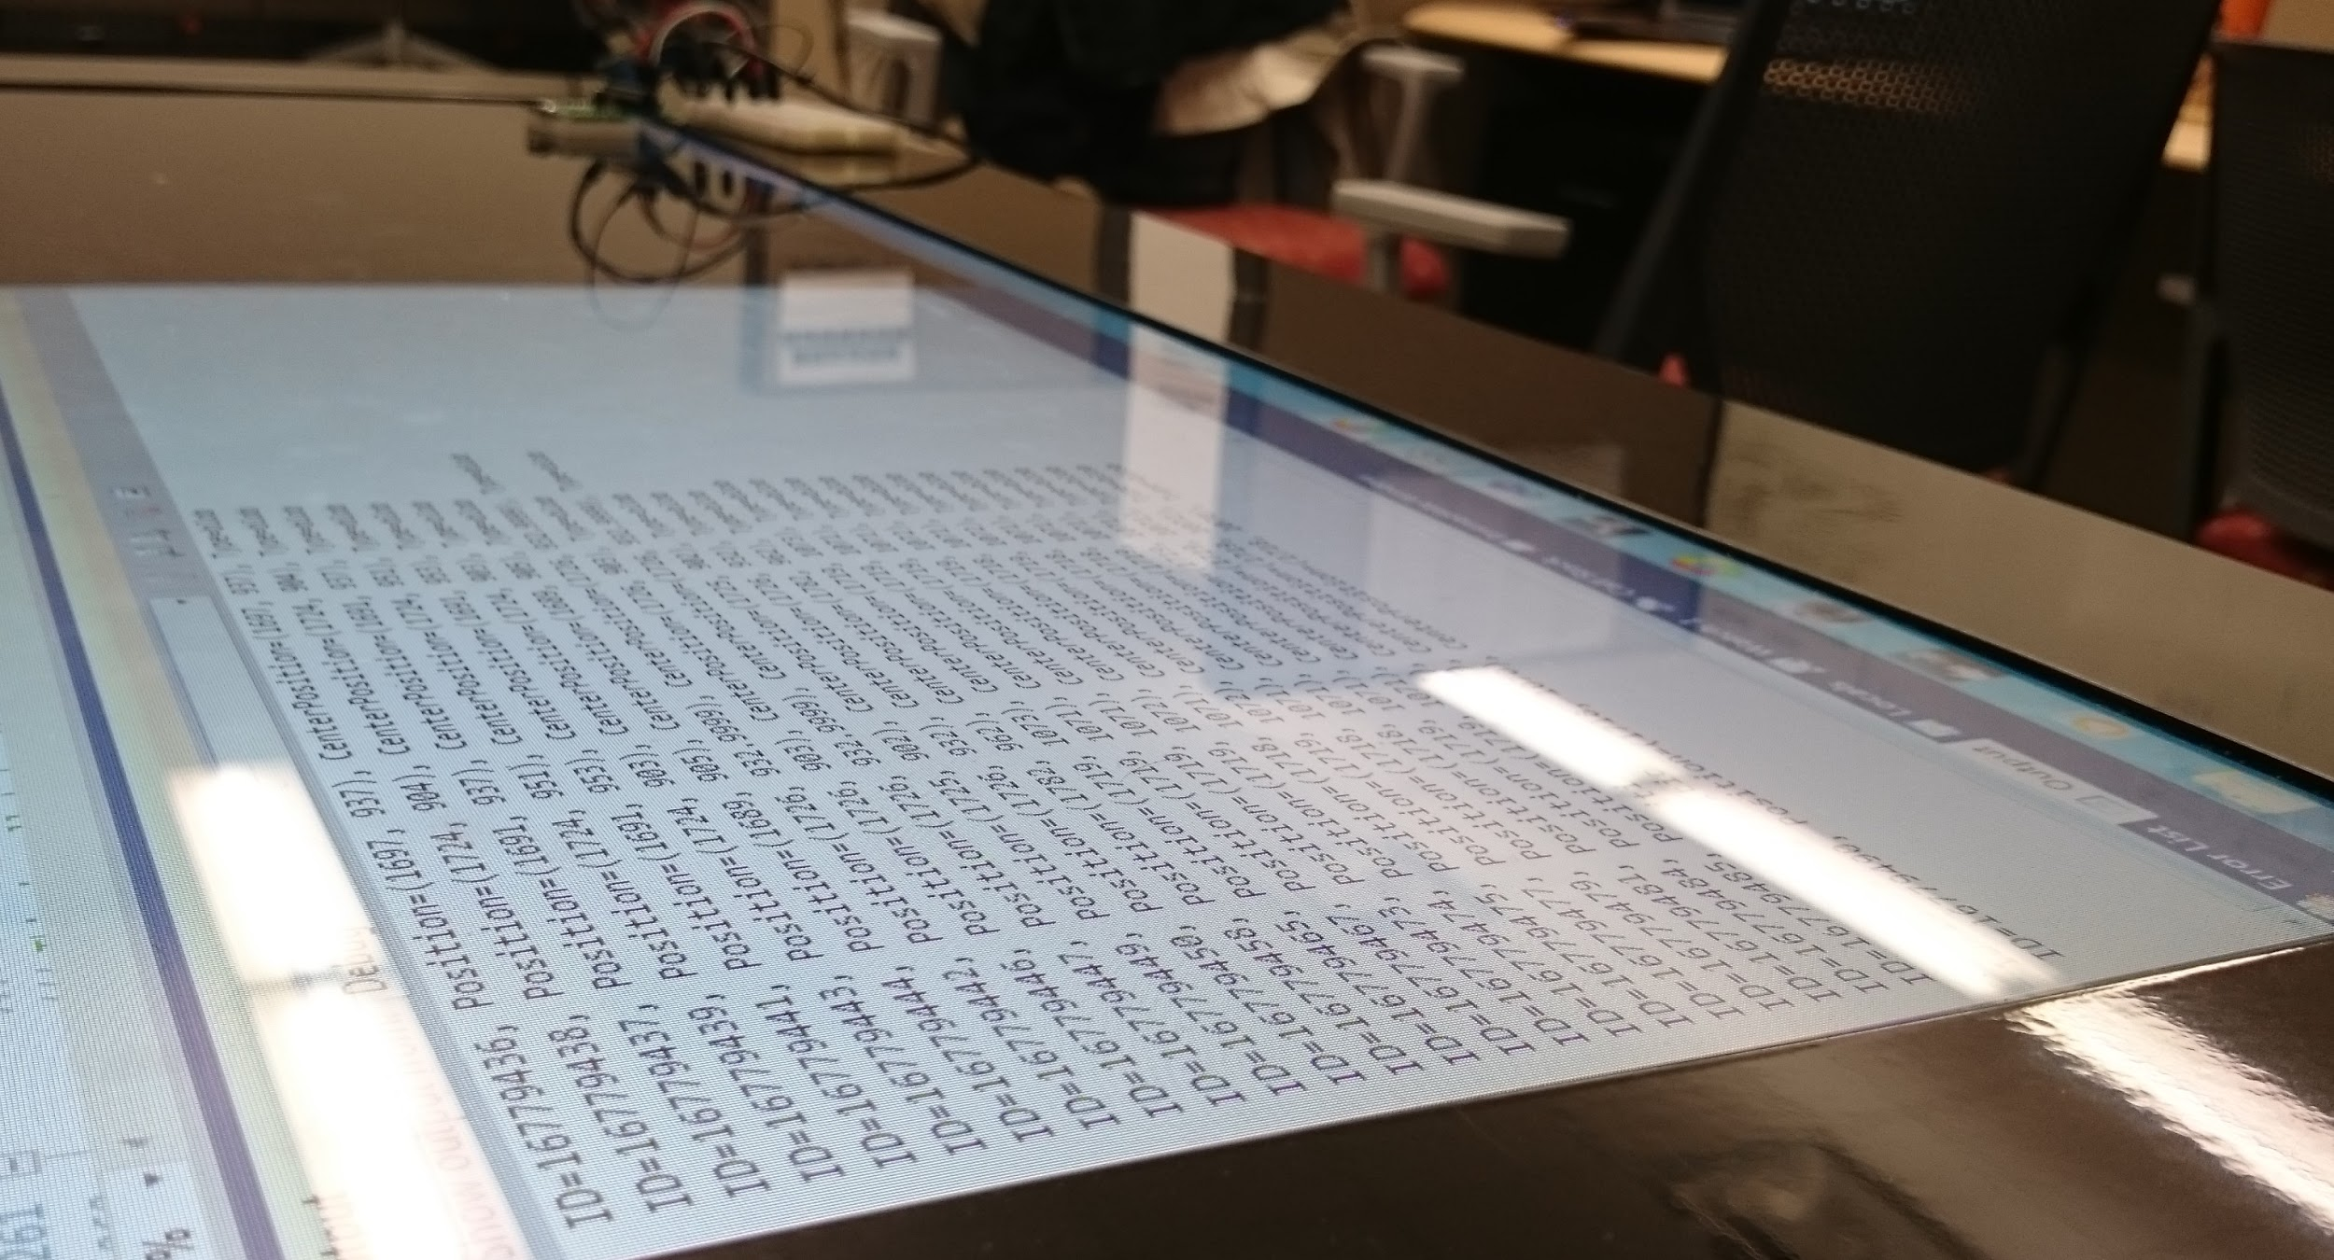
Application (PixelSense-SDK Layer)
Can read IR LEDs on table.
Working on converting them to strings.
Made it working on specific part of screen.

Slide 4
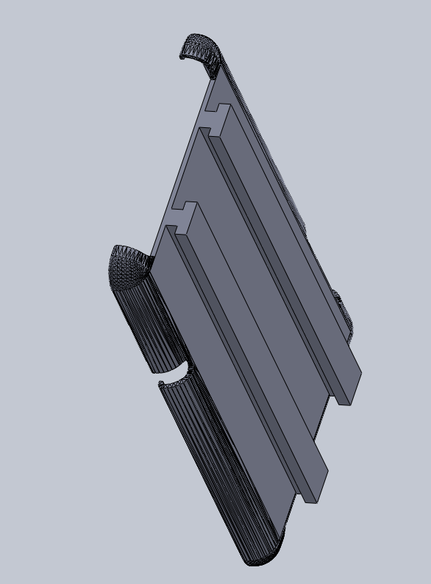
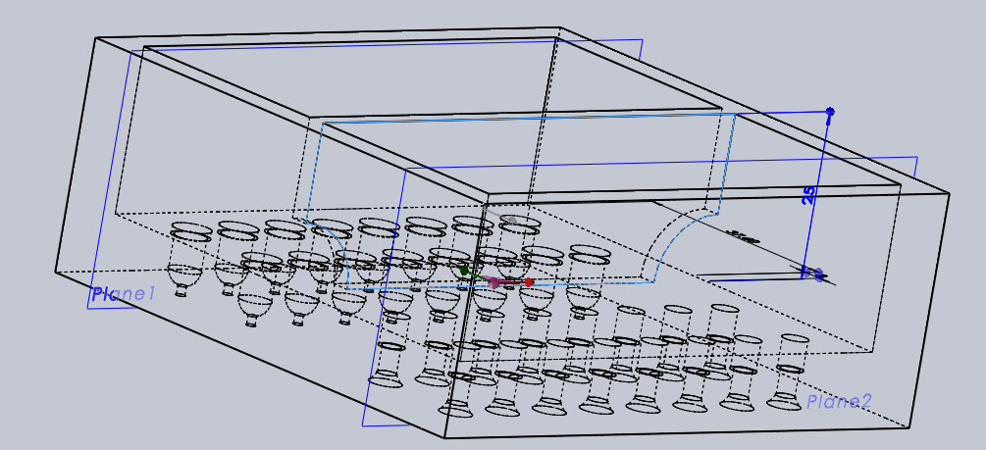
Lynx Case 3D Printing
3 Separate Components:
Lynx Device
Tablet Case
Power Bank Case

Slide 5
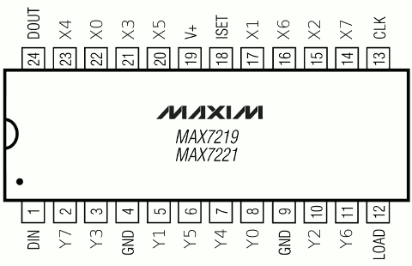
Hardware Builds
LED Array through MAX7219
4x4 array in a 2x8 configuration
Even power distribution
Lower power consumption

Slide 6
Hardware Builds
Phototransistors
Digital vs. Analog readings
Reading rate - 10 reads per second
What’s next

Slide 7

Android Software
Project Repairs
Device Filter disappeared
Library linking broken
App was erroring out but didn’t give a legible reason
Buffer overflow

Slide 8

Android Software
What is working
Serial input/output
External modules are now
properly added
Basic app functionality is
working.

Slide 9

Android Software
What is next
Syncing with the table/Lynx
Error checking/correction
Attempt to send more complex
data

Slide 10
SDK Specifications
Preliminary research has been done to tackle the major features of the SDK
Authentication
Orientation
Data Transfer Metadata
Error Detection

Slide 11
SDK Specifications
Authentication and Orientation
Explored using the LEDs of the Lynx as a unique way to signal its presence without addition features, may use something simpler
Orientation with 3 specific LEDs
Signal with Unique ID parameter (serial number)

Slide 12
SDK Specifications
Error Detection
Researched into effective error detection techniques for data transfer
Modelling after TCP checksum

Slide 13
SDK Specification
Transfer MetaData - Preliminary data header
|------------------------16 bits------------------------|
Identification number
Sequence Number
Acknowledgement
type | Flags | checksum
length

Slide 14
Risk Assessment
Risk | Severity | Probability | Setback | Containment
Hardware failures -Teensy -Nexus 7 -PixelSense -IR LEDs -Phototransistors | Very High | 35% | 1-4 weeks | Use hardware available to test and order new hardware for final product
Android Studio hates us | Moderate | 40% | 3-7 days | Use Eclipse to develop Android application
Shamikul’s addiction to greasy food | Moderate | 134% | 1-2 hours | Utilize wet naps Force Shamikul to wear gloves
Blackjack game on PixelSense table not working | High | 70% | 1 week | Develop a new blackjack application using game engine

Slide 15
Questions?
Fun Fact #261
Zedd, Jonny, and Shamikul have formed a Hip Hop Dance crew called GNB.
They are terrible.
Notes:
:D

